Slide 1


Lecture 1
INT 306 Database Management System
Database System Concepts, 6th Ed.
©Silberschatz, Korth and Sudarshan
See www.db-book.com for conditions on re-use

Slide 2



Database Management System (DBMS)
DBMS contains information about a particular enterprise Collection of interrelated data
Set of programs to access the data
An environment that is both convenient and efficient to use Database Applications:
Banking: transactions
Airlines: reservations, schedules
Universities: registration, grades Sales: customers, products, purchases
Online retailers: order tracking, customized recommendations Manufacturing: production, inventory, orders, supply chain Human resources: employee records, salaries, tax deductions
Databases can be very large. Databases touch all aspects of our lives

Slide 3

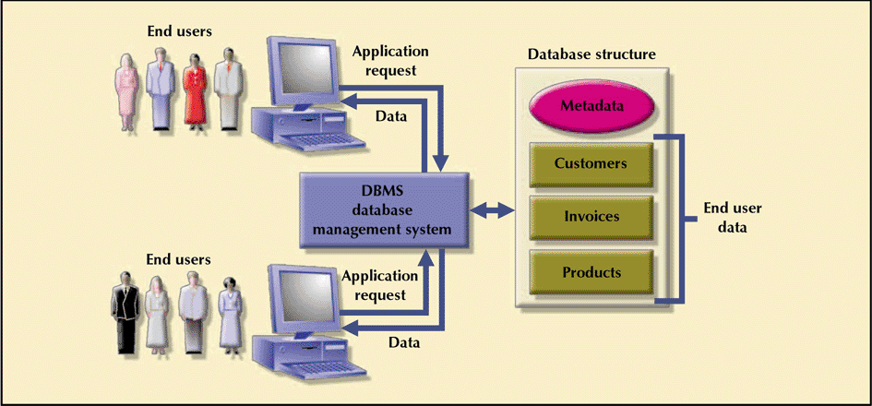
3
Database Management System
- manages interaction between end users and database
Database Systems: Design, Implementation, & Management: Rob & Coronel

Slide 4
University Database Example
Application program examples
Add new students, instructors, and courses
Register students for courses, and generate class rosters
Assign grades to students, compute grade point averages (GPA) and generate transcripts
In the early days, database applications were built directly on top of file systems

Slide 5
Drawbacks of using file systems to store data
Data redundancy and inconsistency
 Multiple file formats, duplication of information in different files
Difficulty in accessing data
 Need to write a new program to carry out each new task Data isolation — multiple files and formats
Integrity problems
 Integrity constraints (e.g., account balance > 0) become “buried” in program code rather than being stated explicitly
 Hard to add new constraints or change existing ones

Slide 6

Drawbacks of using file systems to store data (Cont.)
Atomicity of updates
 Failures may leave database in an inconsistent state with partial updates carried out
 Example: Transfer of funds from one account to another should either complete or not happen at all
Concurrent access by multiple users
 Concurrent access needed for performance
 Uncontrolled concurrent accesses can lead to inconsistencies
– Example: Two people reading a balance (say 100) and updating it by withdrawing money (say 50 each) at the same time
Security problems
 Hard to provide user access to some, but not all, data
Database systems offer solutions to all the above problems

Slide 7
Levels of Abstraction
Physical level: describes how a record (e.g., customer) is stored.
Logical level: describes data stored in database, and the relationships among the data.
type instructor = record
ID : string;
name : string; dept_name : string; salary : integer;
end;
View level: application programs hide details of data types. Views can also hide information (such as an employee’s salary) for security purposes.

Slide 8
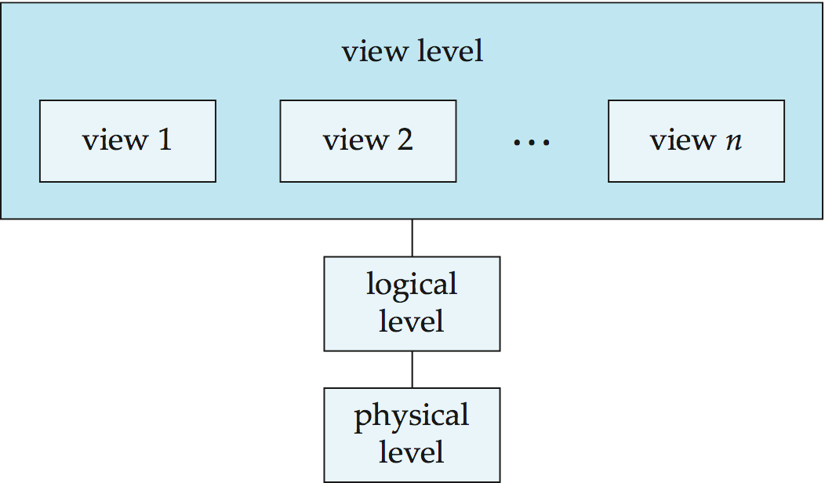
Three Tier Architecture
An architecture for a database system

Slide 9

Users of DBMS
Data Base Administrator
Database Designer
End User
System Analyst and Application Programmer

Slide 10



Instances and Schemas
Similar to types and variables in programming languages
Schema – the logical structure of the database
Example: The database consists of information about a set of customers and accounts and the relationship between them
Analogous to type information of a variable in a program
Physical schema: database design at the physical level
Logical schema: database design at the logical level
Instance – the actual content of the database at a particular point in time Analogous to the value of a variable
Physical Data Independence – the ability to modify the physical schema without changing the logical schema
Applications depend on the logical schema
In general, the interfaces between the various levels and components should
be well defined so that changes in some parts do not seriously influence others.

Slide 11
Data Models
A collection of tools for describing
Data
Data relationships Data semantics Data constraints
Relational model
Entity-Relationship data model (mainly for database design)
Object-based data models (Object-oriented and Object-relational)
Semistructured data model (XML) Other older models:
Network model
Hierarchical model

Slide 12
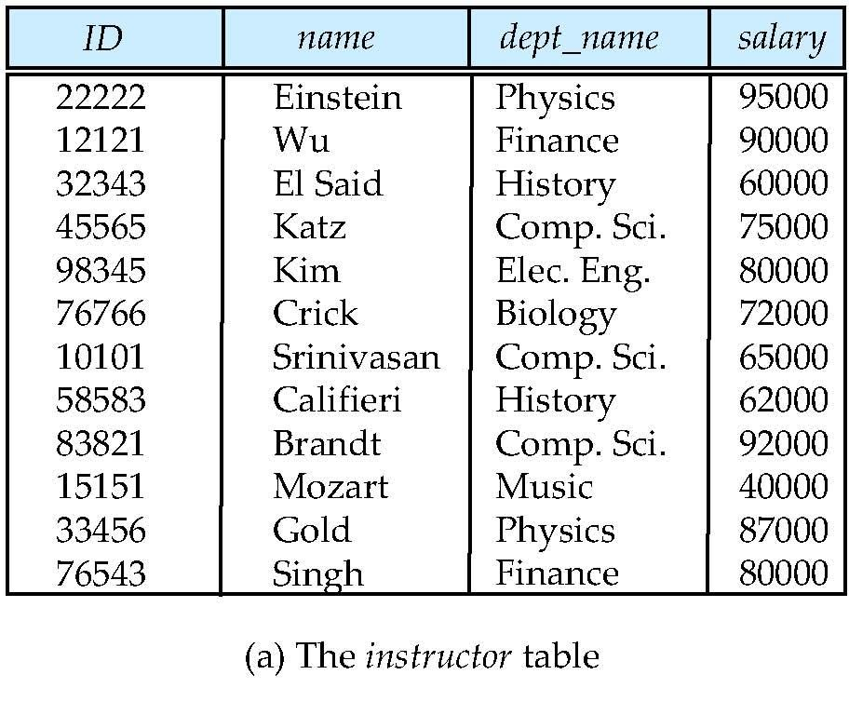
Relational Model
Relational model (Chapter 2)
Example of tabular data in the relational model
Columns
Rows

Slide 13
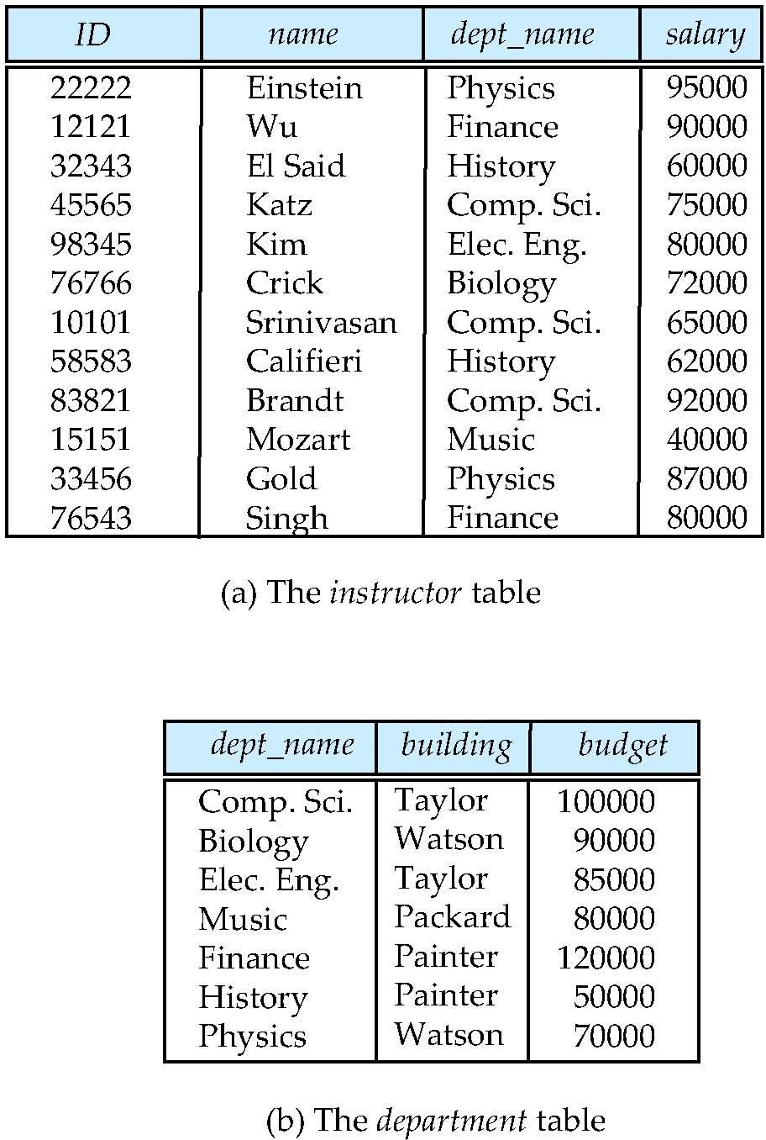
A Sample Relational Database

Slide 14
Data Manipulation Language (DML)
Language for accessing and manipulating the data organized by the appropriate data model
DML also known as query language
Two classes of languages
Procedural – user specifies what data is required and how to get those data
Declarative (nonprocedural) – user specifies what data is required without specifying how to get those data
SQL is the most widely used query language

Slide 15
Data Definition Language (DDL)
Specification notation for defining the database schema Example: create table instructor (
ID
name
char(5), varchar(20),
dept_name varchar(20),
salary numeric(8,2))
DDL compiler generates a set of table templates stored in a data dictionary
Data dictionary contains metadata (i.e., data about data) Database schema
Integrity constraints
 Primary key (ID uniquely identifies instructors)
 Referential integrity (references constraint in SQL)
– e.g. dept_name value in any instructor tuple must appear in
department relation
Authorization

Slide 16
Data Control Language (DCL)
DCL includes statements which control access to data and database. Privilege can be granted to user using GRANT statement.
REVOKE command is used to take back the privileges.

Slide 17
SQL
SQL: widely used non-procedural language
Example: Find the name of the instructor with ID 22222
select from where
name
instructor instructor.ID = ‘22222’
Example: Find the ID and building of instructors in the Physics dept.
select instructor.ID, department.building
from instructor, department
where instructor.dept name = “physics”
Application programs generally access databases through one of
Language extensions to allow embedded SQL
Application program interface (e.g., ODBC/JDBC) which allow SQL queries to be sent to a database

Slide 18
Database Design
The process of designing the general structure of the database:
Logical Design – Deciding on the database schema. Database design
requires that we find a “good” collection of relation schemas.
Business decision – What attributes should we record in the database?
Computer Science decision – What relation schemas should we have and how should the attributes be distributed among the various relation schemas?
Physical Design – Deciding on the physical layout of the database

Slide 19
History of Database Systems
1950s and early 1960s:
Data processing using magnetic tapes for storage
 Tapes provided only sequential access Punched cards for input
Late 1960s and 1970s:
Hard disks allowed direct access to data
Network and hierarchical data models in widespread use
Ted Codd defines the relational data model
 Would win the ACM Turing Award for this work
 IBM Research begins System R prototype
 UC Berkeley begins Ingres prototype
High-performance (for the era) transaction processing

Slide 20
History (cont.)
1980s:
Research relational prototypes evolve into commercial systems
 SQL becomes industrial standard Parallel and distributed database systems Object-oriented database systems
1990s:
Large decision support and data-mining applications Large multi-terabyte data warehouses
Emergence of Web commerce Early 2000s:
XML and XQuery standards
Automated database administration Later 2000s:
Giant data storage systems
 Google BigTable, Yahoo PNuts, Amazon, ..

